Slide 1
Regression Testing UNIT-III
Prepared By: Neha Tripathi

Slide 2
Regression testing
Lecture 1

Slide 3
Regression Testing
Regression testing is the selective retesting of a system or component to verify that modifications have not caused unintended effects and that the system or component still complies with its specified requirements.
Regression testing can also be defined as the software maintenance task performed on a modified program to instill confidence that changes are correct and have not adversely affected the unchanged portions of the program.
Purpose:
The purpose of regression testing is to ensure that bug-fixes and new functionalities introduced in a new version of the software do not adversely affect the correct functionality inherited from the previous version.

Slide 4
PROGRESSIVE VS. REGRESSIVE TESTING
Whatever test case design methods or testing techniques, discussed until now, have been referred to as progressive testing or development testing. From verification to validation, the testing process progresses towards the release of the product.
However, to maintain the software, bug fixing may be required during any stage of development and therefore, there is a need to check the software again to validate that there has been no adverse effect on the already working software. A system under test ( SUT) is said to regress if
- a modified component fails, or
- a new component, when used with unchanged components, causes failures in the unchanged components by generating side-effects or feature interactions.
Thus, it can be said that most test cases begin as progressive test cases and eventually become regression test cases.

Slide 5
REGRESSION TESTING PRODUCES QUALITY SOFTWARE
Changed software requires to be fully tested again so as to ensure:
(a) bug-fixing has been carried out successfully,
(b)the modifications have not affected other unchanged modules,
(c) the new requirements have been incorporated correctly.
Every time we make a change in the software for whatever reasons, we have to perform a set of regression tests to validate the software. This process of executing the whole set of test again and again may be time-consuming and frustrating, but it increases the quality of software.
Therefore, the creation, maintenance, and execution of a regression test suite helps to retain the quality of the software.

Slide 6
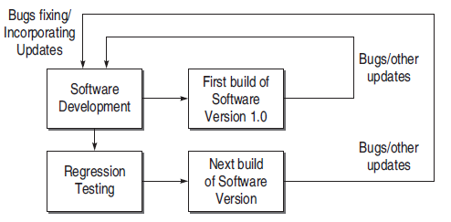
Regression testing produces Quality Software

Slide 7
Importance of Regression Testing
Indeed, the importance of regression testing is well-understood for the following reasons:
- It validates the parts of the software where changes occur.
- It validates the parts of the software which may be affected by some changes, but otherwise unrelated.
- It ensures proper functioning of the software, as it was before changes occurred.
- It enhances the quality of software, as it reduces the risk of high-risk bugs.

Slide 8
OBJECTIVES OF REGRESSION TESTING
It tests to check that the bug has been addressed
The first objective in bug-fix testing is to check whether the bug-fixing has worked or not. Therefore, you run exactly the same test that was executed when the problem was first found. If the program fails on this testing, it means the bug has not been fixed correctly and there is no need to do any regression testing further.
If finds other related bugs
It may be possible that the developer has fixed only the symptoms of the reported bugs without fixing the underlying bug. Moreover, there may be various ways to produce that bug. Therefore, regression tests are necessary to validate that the system does not have any related bugs.
It tests to check the effect on other parts of the program
It may be possible that bug-fixing has unwanted consequences on other parts of a program. Therefore, regression tests are necessary to check the influence of changes in one part on other parts of the program.

Slide 9
WHEN IS REGRESSION TESTING DONE?
Software Maintenance
- Corrective maintenance
Changes made to correct a system after a failure has been observed (usually after general release).
- Adaptive maintenance
Changes made to achieve continuing compatibility with the target environment or other systems.
- Perfective maintenance
Changes designed to improve or add capabilities.
- Preventive maintenance
Changes made to increase robustness, maintainability, portability, and other features.

Slide 10
continue….
Rapid Iterative Development
The extreme programming approach requires that a test be developed for each class and that this test be re-run every time the class changes.
First Step of Integration
Re-running accumulated test suites, as new components are added to successive test configurations, builds the regression suite incrementally and reveals regression bugs.
Compatibility Assessment and Benchmarking
Some test suites are designed to be run on a wide range of platforms and applications to establish conformance with a standard or to evaluate time and space performance. These test suites are meant for regression testing, but not intended to reveal regression bugs.

Slide 11
REGRESSION TESTING TYPES
Bug-Fix regression
This testing is performed after a bug has been reported and fixed. Its goal is to repeat the test cases that expose the problem in the first place.
Side-Effect regression/Stability regression
It involves retesting a substantial part of the product. The goal is to prove that the change has no detrimental effect on something that was earlier in order. It tests the overall integrity of the program, not the success of software fixes.
…….

Slide 12
Regression testing
Lecture 2

Slide 13
REGRESSION TEST PROBLEM
Regression testing is considered a problem, as the existing test suite with probable additional test cases needs to be tested again and again whenever there is a modification.
The following difficulties occur in retesting:
- Large systems can take a long time to retest.
- It can be difficult and time-consuming to create the tests.
- It can be difficult and time-consuming to evaluate the tests. Sometimes, it requires a person in the loop to create and evaluate the results.
- Cost of testing can reduce resources available for software improvements.

Slide 14
continue….
Notations used:
P denotes a program or procedure,
P ‘ denotes a modified version of P,
S denotes the specification for program P,
S ‘ denotes the specification for program P ‘,
P(i) refer to the output of P on input i,
P ‘(i) refer to the output of P ‘ on input i, and
T = {t1,….. tn} denotes a test suite or test set for P.

Slide 15
continue….
REGRESSION TESTING PROBLEM
Given a program P, its modified version P ‘, and a test set T that was used earlier to test P; find a way to utilize T to gain sufficient confidence in the correctness of P ‘.

Slide 16
REGRESSION TESTING TECHNIQUES
There are three different techniques for regression testing
Regression test selection technique
This technique attempt to reduce the time required to retest a modified program by selecting some subset of the existing test suite.
Test case prioritization technique
Regression test prioritization attempts to reorder a regression test suite so that those tests with the highest priority, according to some established criteria, are executed earlier in the regression testing process rather than those with lower priority. There are two types of prioritization:
(a) General Test Case Prioritization
For a given program P and test suite T, we prioritize the test cases in T that will be useful over a succession of subsequent modified versions of P, without any knowledge of the modified version.
(b) Version-Specific Test Case Prioritization
We prioritize the test cases in T, when P is modified to P ‘, with the knowledge of the changes made in P.

Slide 17
continue…..
Test suite reduction technique
It reduces testing costs by permanently eliminating redundant test cases from test suites in terms of codes or functionalities exercised.

Slide 18
SELECTIVE RETEST TECHNIQUE
It is the process of selecting a subset of the regression test suite that tests the changes.
The objective of selective retest technique is cost reduction.
- Software maintenance includes more than 60% of development costs.
- Selective retest techniques attempt to reduce the cost of testing by identifying the portions of P ‘ that must be exercised by the regression test suite.

Slide 19
Characteristic of the Selective Retest Technique
It minimizes the resources required to regression test a new version.
It is achieved by minimizing the number of test cases applied to the new version.
It is needed because a regression test suite grows with each version, resulting in broken, obsolete, uncontrollable, redundant test cases.
It analyses the relationship between the test cases and the software elements they cover.
It uses the information about changes to select test cases.

Slide 20
Steps in Selective Retest Technique
Rothermel and Harrold have characterized the typical steps taken by this technique in the following manner:
1. Select T ‘ subset of T, a set of test cases to execute on P ‘.
2. Test P ‘ with T ‘, establishing correctness of P ‘ with respect to T ‘.
3. If necessary, create T ‘’, a set of new functional or structural test cases for P ‘.
4. Test P ‘ with T ‘’,establishing correctness of P ‘ with respect to T ‘’.
5. Create T ‘’’, a new test suite and test execution profile for P ‘, from T, T ‘, and T ‘’.

Slide 21
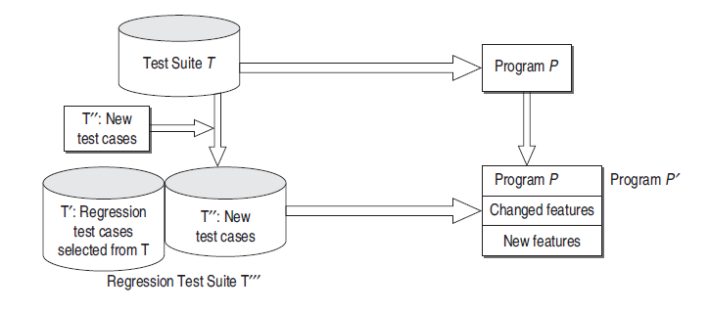
continue…..

Slide 22
continue….
Each of these steps involves the following important problems:
Regression test selection problem
Step 1 involves this problem. The problem is to select a subset T ‘ of T with which P ‘ will be tested.
Coverage identification problem
Step 3 addresses this problem. The problem is to identify portions of P ‘ or its specifications that requires additional testing.
Test suite execution problem
Steps 2 and 4 address the test suite execution problem. The problem is to execute test suites efficiently and checking test results for correctness.
Test suite maintenance problem
Step 5 addresses this problem. The problem is to update and store test information.

Slide 23
continue….
Strategy for Test Case Selection
A decision procedure for selecting the test cases is provided by a test criterion.
- Selection Criteria Based on Code
- Fault-revealing test cases
- Modification-revealing test cases
- Modification-traversing test cases

Slide 24
continue….
Regression Test Selection Techniques
We consider the following selective retest techniques:
- Minimization techniques
Minimization-based regression test selection techniques attempt to select minimal sets of test cases from T that yield coverage of modified or affected portions of P.
- Dataflow techniques
Dataflow coverage-based regression test selection techniques select test cases that exercise data interactions that have been affected by modifications.

Slide 25
continue….
-Safe techniques
Techniques that are not safe can fail to select a test case that would have revealed a fault in the modified program. In contrast, when an explicit set of safety conditions can be satisfied, safe regression test selection techniques guarantee that the selected subset T ‘ contains all test cases in the original test suite T that can reveal faults in P ‘.
- Ad hoc/Random techniques
When time constraints prohibit the use of a retest all approach, but no test selection tool is available, developers often select test cases based on ‘intuitions’ or loose associations of test cases with functionality. Another simple approach is to randomly select a predetermined number of test cases from T.
-Retest-all technique
The retest-all technique simply reuses all existing test cases. To test P ‘, the technique effectively selects all test cases in T.

Slide 26
continue…..
Evaluating Regression Test Selection Techniques
- Inclusiveness
It measures the extent to which M chooses modification revealing test from T for inclusion in T’, where M is a regression test selection technique.
- Precision
It measures the extent to which M omits tests that are non modification-revealing.
- Efficiency
The efficiency of regression test selection techniques is measured in terms of their space and time requirements. both space and time efficiency depends on the size of the test suite that a technique selects, and on the computational cost of that technique.

